Slide 1
Agent Based Modeling of Herds and Spatial Metrics for Animal Movement
Beth Johnson
johnsel@math.umd.edu
Advisor:
Dr. Bill Fagan
Department of Biology
bfagan@umd.edu

Slide 2
Background
There are many different mechanisms that animals may use to direct movement
Non-oriented – random movement
Oriented – movement directed by a stimulus (visual observation of food)
Spatial memory – uses previous information, passed through individuals or generations
Animals may use more than one or all three movement mechanisms
No current movement theory to unify all three mechanisms

Slide 3
Background
There are three different population level distributions that animals exhibit
Sedentary ranges – individual occupies relatively small area compared to population range
Migration – regular movement to and from spatially disjoint ranges
Nomadism – does not follow regular temporal and spatial patterns
Need a way to evaluate and qualify dispersion patterns at the population level that does not rely on an assumption of one of these three types of distributions

Slide 4
Background
Mueller, Thomas, and William F. Fagan. "Search and navigation in dynamic environments–from individual behaviors to population distributions." Oikos 117.5 (2008): 654-664.

Slide 5
Approach – ‘Evolve’ an Agent Based Model with ANN
Fix landscape variability
Evolve agents for landscape (stage 1)
Create herd from best agent
(stage 2)
Determine spatial statistics
Realized Movement Index
Population Dispersion Index
Movement Correlation Index
Gazelle Relocation Data

Slide 6
Landscape
resource patches
+
agent

Slide 7
Landscape Variability
Patch size
1
75%
Predictability
generations
50%

Slide 8
Approach – ‘Evolve’ an Agent Based Model with ANN
Fix landscape variability
Evolve agents for landscape (stage 1)
Create herd from best agent
(stage 2)
Determine spatial statistics
Realized Movement Index
Population Dispersion Index
Movement Correlation Index
Gazelle Relocation Data

Slide 9
Evolve agents for landscape
Set landscape
Select random starting location
Allow agent i to move 1 step across landscape
for 1:time steps
Randomly initialize weights of agents
Record resources, update landscape
for agents i < N
Create 6 copies of that agent
(with mutation + crossover)
Find agent with most resources
Randomly select 6 agents
Until all agents selected

Slide 10
Agent Movement
1. One agent is on the grid at a time, completes all time steps.
2. Agent can move to any of eight adjacent cells (orange).
x
3. If there is a resource in the cell, agent consumes resource and resource is depleted for remaining time steps. +1 to resource counter.
x
x
x
x

Slide 11
Agent Movement
Mechanism
Input Layer
Hidden Layer
Output Layer
Bias
non-oriented
Resource Uptake (total)
1
5
Resource Uptake (last 8 steps)
Search Effort
2
4
oriented
Resources in 8-cell neighborhood
spatial memory
Current x location
Current y location
3
6
Step counter
Inputs are scaled to be [-1,1], values at hidden and output nodes determined by the following, where weights are integers [-5,5]
Mueller, Thomas, William F. Fagan, and Volker Grimm. "Integrating individual search and navigation behaviors in mechanistic movement models.” Theoretical Ecology 4.3 (2011): 341-355.

Slide 12
Agent Movement
[0, ¹/₃)
[¹/₃,²/₃)
If Output Node 4 is __
Non-oriented: If Output Node 5 is __
Oriented: If __ resources are visible
[²/₃,1]
Move same direction as previous time step
Go to resource
Memory:
If Output Node 6 is __
[0, ¹/₃)
1
Move 45 degrees from direction in previous time
Go to randomly selected resource
[¹/₃,²/₃)
>1
Move in random direction
[²/₃,1]
0

Slide 13
Approach – ‘Evolve’ an Agent Based Model with ANN
Fix landscape variability
Evolve agents for landscape (stage 1)
Create herd from best agent
(stage 2)
Determine spatial statistics
Realized Movement Index
Population Dispersion Index
Movement Correlation Index
Gazelle Relocation Data

Slide 14
Herd Movement
All agents is on the grid at a time, all complete one time step (updated in a random order each time step)
Agent can move to any of eight adjacent cells (orange) that is unoccupied
If there is a resource in the cell, agent consumes resource and cell resource is decreased by 1. When resource cell is empty, it is resource is depleted for 5 time steps.
2
1
3
2
2
1
1
3
3

Slide 15
Approach – ‘Evolve’ an Agent Based Model with ANN
Fix landscape variability
Evolve agents for landscape (stage 1)
Create herd from best agent
(stage 2)
Determine spatial statistics
Realized Movement Index
Population Dispersion Index
Movement Correlation Index
Gazelle Relocation Data

Slide 16
Spatial Metrics
Realized Mobility Index: describes how much of the annual population range an individual was using
Population Dispersal Index: how clustered the individuals are at different spatial scales
Movement Correlation Index: describes how much individual movements were correlated with other individuals movements
Mueller, Thomas, et al. "How landscape dynamics link individual‐to population‐level movement patterns: a multispecies comparison of ungulate relocation data." Global Ecology and Biogeography 20.5 (2011): 683-694.

Slide 17
Realized Mobility Index
Find minimum convex polygon for each individual and entire population
Will use minimum planar convex hull algorithm by Kirkpatrick and Seidel (1986)

Slide 18
Realized Mobility Index
RMI is ratio of area of polygon for individual to the area of the polygon for the population

Slide 19
Movement Correlation Index
Assume movements are described by discrete time based Gaussian position jump process, N individuals, M steps
Impose global mean (μ_{x}, μ_{y}), global variance (σ²), and global correlation (ρ) on all individuals
Use maximum likelihood to estimate parameters
Interested in position correlation (ρ)
Calabrese, Justin, Chris H. Fleming, Bill F. Fagan, Marin Rimmler, Petra Kaczensky, Peter Leimgruber, and Thomas Mueller. From the fish tank to the Gobi desert: A general, scalable approach to quantifying animal movement coordination. (2013)

Slide 20
Movement Correlation Index
Want to maximize
Closed form solution exists
N x N
N x 1
N x 1
Calabrese, Justin, Chris H. Fleming, Bill F. Fagan, Marin Rimmler, Petra Kaczensky, Peter Leimgruber, and Thomas Mueller. From the fish tank to the Gobi desert: A general, scalable approach to quantifying animal movement coordination. (2013)

Slide 21
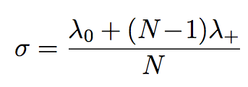
Movement Correlation Index
Closed form solution
Calabrese, Justin, Chris H. Fleming, Bill F. Fagan, Marin Rimmler, Petra Kaczensky, Peter Leimgruber, and Thomas Mueller. From the fish tank to the Gobi desert: A general, scalable approach to quantifying animal movement coordination. (2013)

Slide 22
Population Dispersal Index
For each individual, compute the bivariate k function at distance s (expected value of points in Pattern 2 distance s from Pattern 1)
Pattern 1 is the points for individual, # points m₁
Pattern 2 is the points for entire population minus the individual, # points m₂
This function cycles through every point in pattern 1 and counts points in pattern 2 that are within distance s or less.

Slide 23
Population Dispersal Index
s

Slide 24
Population Dispersal Index
W(p₂,p₁) = .8
If the point is outside distance s, do not count it. If it is inside distance s, count it, but account for edge effects.
W(p₁, p₂) = 1
W(p_{i},p_{j}) is the fraction of the circumference of the circle (centered at p_{i} crossing through p_{j}) within the total population boundary.

Slide 25
Implementation
R (freely available)
Run on Macbook pro
2.9 GHz Intel Core i7
8 GB RAM

Slide 26
Validation – ABM
Landscape implementation can be validated by computing average resource value in a cell over many generations
Individual agents NN are small enough to be validated by hand
Genetic evolution can be verified by edge cases (crossover rate, mutation rate = 0, efficiency should be constant after a few generations)
Stage 1 can be compared to implementation in C

Slide 27
Validation – Spatial Statistics
RMI
‘easy’ set of points that can be computed
chull function (uses different algorithm for finding hull, but results should be the same)
PDI
k12hat function in R
MCI
Hand (or excel) computation with small data set
Compare with MATLAB implementation

Slide 28
Testing – Agent Based Model
Will vary the input parameters to the model
Patch size
Landscape predictability

Slide 29
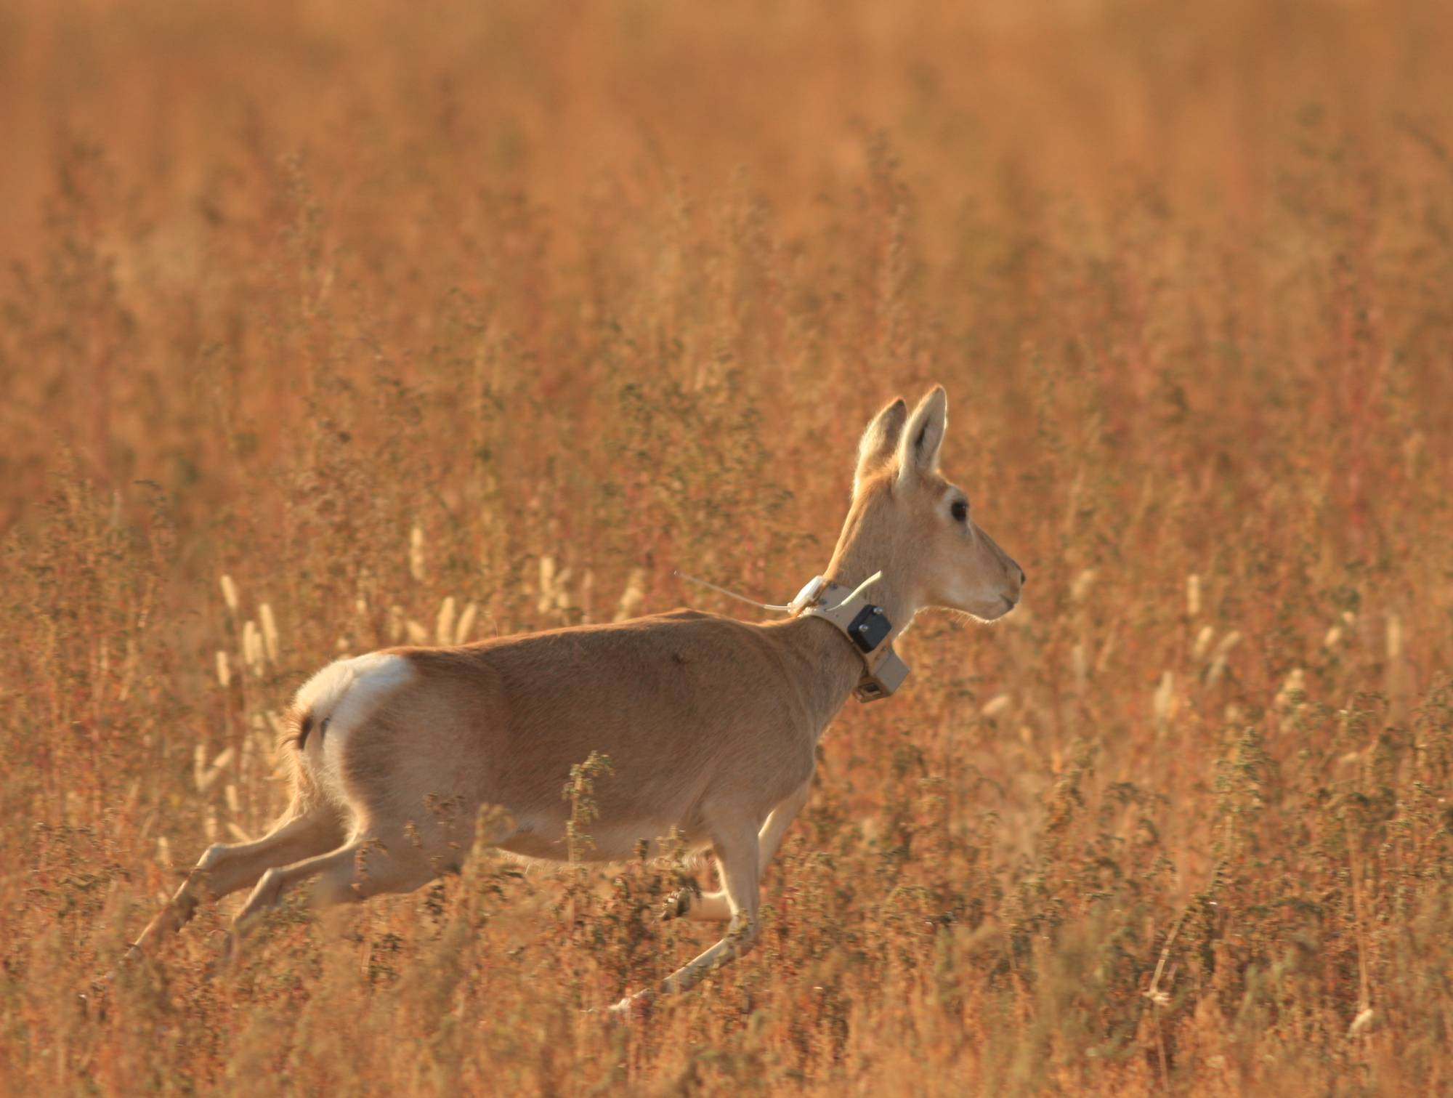
Testing – Spatial Statistics
Data sets generated from ABM
Test with data sampled at differing intervals
Vary the size of data set generated to determine how performance is affected
Gazelle data
36 individuals, x and y position data at various times (1 to 25 hour intervals) ranging from 50 to 978 days total

Slide 30
Deliverables
Proposal Presentation + Proposal Document
Mid-year Presentation + Mid-year report
Final Presentation + Final Report
R code for agent based model
R code for computing RMI, PDI, and MCI
Data sets used
Documentation for code + examples for use

Slide 31
Project Schedule/Milestones
October – Set up data structures for agents, code to initialize landscape and agents
November – Implement and validate genetic algorithm + neural networks
December - Implement stage 1 (evolving agents) create mid year report and presentation
Late January - Implement stage 2 (herd of agents)
Feb – Implement RMI, PDI, and MCI
March - Validate overall agent model and spatial metrics
April – Test spatial metrics with gazelle data + simulation data
May – Create final report + presentation, documentation + examples for spatial metrics code
Time permitting: parallel versions of spatial metrics(if necessary with large data sets), parallel version of agent based model (stage 1), visualization of simulation

Slide 32
References
Calabrese, Justin, Chris H. Fleming, Bill F. Fagan, Marin Rimmler, Petra Kaczensky, Peter Leimgruber, and Thomas Mueller. From the fish tank to the Gobi desert: A general, scalable approach to quantifying animal movement coordination. (Unpublished, 2013)
Kirkpatrick, David G., and Raimund Seidel. "The ultimate planar convex hull algorithm?." SIAM journal on computing 15.1 (1986): 287-299.
Lotwick, H. W., and B. W. Silverman. "Methods for analysing spatial processes of several types of points." Journal of the Royal Statistical Society. Series B (Methodological) (1982): 406-413.
Mueller, Thomas, William F. Fagan, and Volker Grimm. "Integrating individual search and navigation behaviors in mechanistic movement models."Theoretical Ecology 4.3 (2011): 341-355.
Mueller, Thomas, and William F. Fagan. "Search and navigation in dynamic environments–from individual behaviors to population distributions." Oikos117.5 (2008): 654-664.
Mueller, Thomas, et al. "How landscape dynamics link individual‐to population‐level movement patterns: a multispecies comparison of ungulate relocation data." Global Ecology and Biogeography 20.5 (2011): 683-694.

